Slide 1
Cancer in teenagers
1st Hartford Scouts Raising Awareness

Slide 2
What is Cancer?

Slide 3
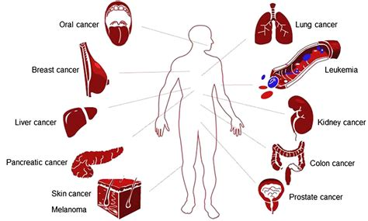
Types of Cancer

Slide 4
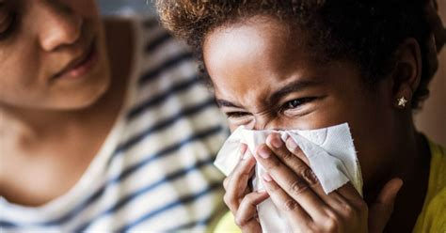
Symptoms of Cancer

Slide 5
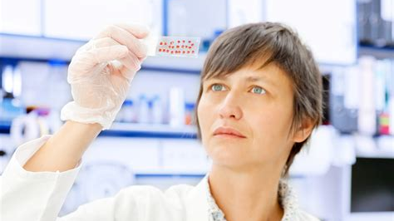
Treatment for cancer

Slide 6
Cancer in young people - Statistics

Slide 7
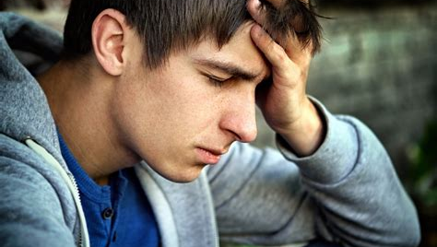
Why Cancer is harder for teenagers.

Slide 8
Fundraising ideas

