Slide 1
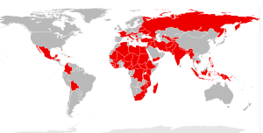
Medecins Sans Frontieres and the Afghanistan Crisis
Notes:
Lou to present

Slide 2
Troop Night Activities
Kite Making – a traditional game played by children in Afghanistan
Cook Gosh-e-Feel (Elephant Ear Pastries) a favourite sweet food eaten in Afghanistan
Notes:
Lou to present

Slide 3
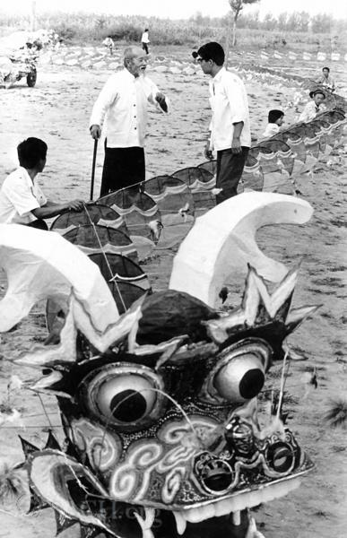
Kite Flying History
It is believed that kites were first used in the South Sea Islands for fishing. They would attach bait to the tail of the kite together with a sort of net to catch the fish. This technique is still in used today.
It is likely that the inspiration for the kite came from ancient Chinese watching the effect of the wind on leaves, bamboo hats or sails.
Instead of being playthings, early kites were used for military purposes. Historical records say they were large in size; some were powerful enough to carry men up in the air to observe enemy movements, and others were used to scatter propaganda leaflets over hostile forces.
Since then, the kite industry has taken leaps and bounds with the creation of stunt and power kites designed to go faster and perform more intricate tricks than ever before.

Slide 4
Kite Flying
Kite flying is popular in many Asian countries, where it often takes the form of "kite fighting", in which participants try to snag each other's kites or cut other kites down.^{[35]} Fighter kites are usually small, flat, flattened diamond-shaped kites made of paper and bamboo. Tails are not used on fighter kites so that they are more agile.
In Afghanistan, kite flying is a popular game, and is known in Dari. Some kite fighters pass their strings through a mixture of ground glass powder and glue, which is legal. The resulting strings are very abrasive and can sever the competitor's strings more easily. The abrasive strings can also injure people.
During the Taliban rule in Afghanistan, kite flying was banned, among various other recreations.

