Slide 1
Deforestation
By Cobra

Slide 2
Deforestation is the permanent removal of trees to make room for something besides forest. Deforestation can include clearing the land for farming or livestock, or using the timber for fuel, construction or manufacturing.
Deforestation (Also know as logging which is illegal)

Slide 3
Deforestation has two global effects

Slide 4
First, is Climate change.
Logging causes this because loggers burn the wood for fuel which releases CO2 or Carbon Dioxide.
When you remove trees from the earth, they release even more CO2 because trees store gases .

Slide 5
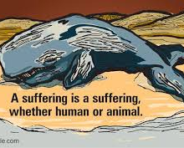
Second is endangering animals
When they remove the trees, they are also removing animal's habitats. This Is killing many already endangered animals.

Slide 6
HOW YOU CAN HELP
There are lots of different ways to help stop deforestation :
Plant a tree.
Go paperless.
Recycle and buy recycled products.
Look for Forest Stewardship Council (FSC) certification on wood and wood products.
Eat vegetarian meals as often as possible

Slide 7
Any Questions?

